Slide 1
C773 – Task 2
Brad Erlenbach
Student ID: 011269060
berlen1@wgu.edu

Slide 2
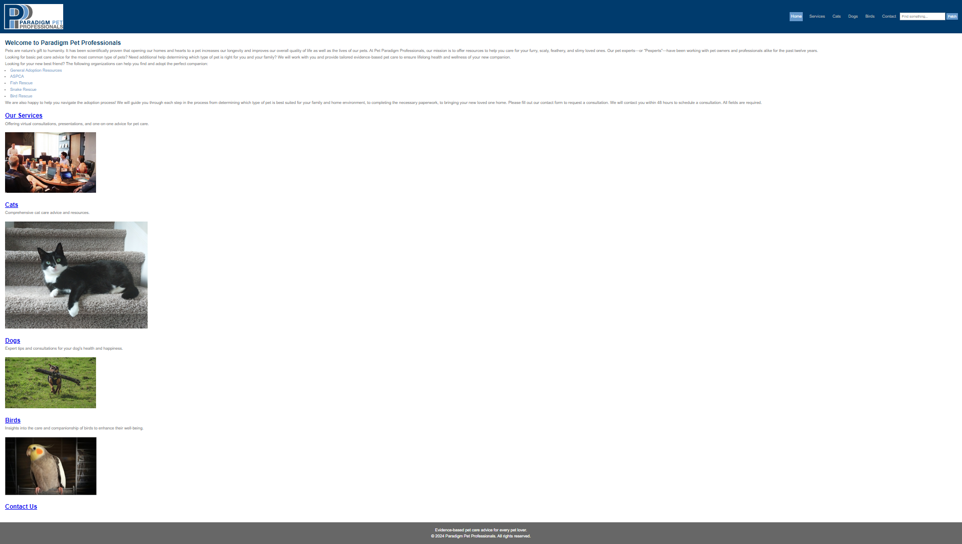

Slide 3
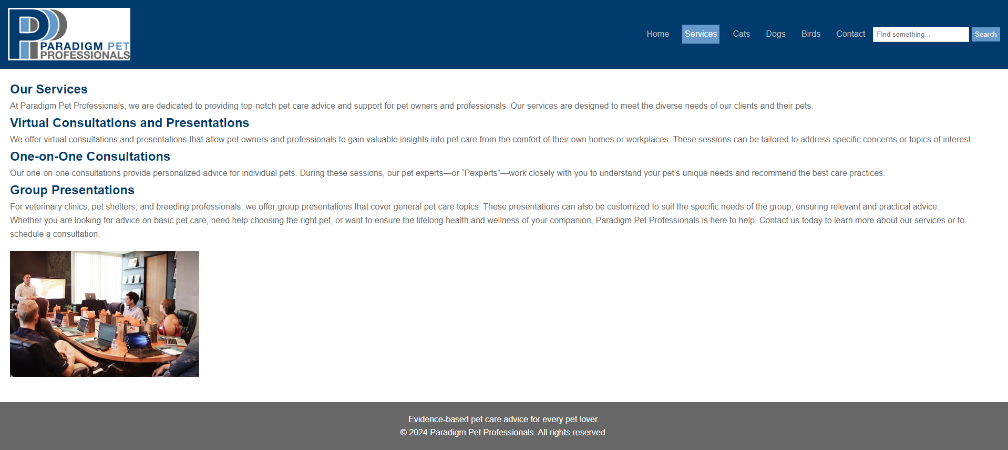

Slide 4
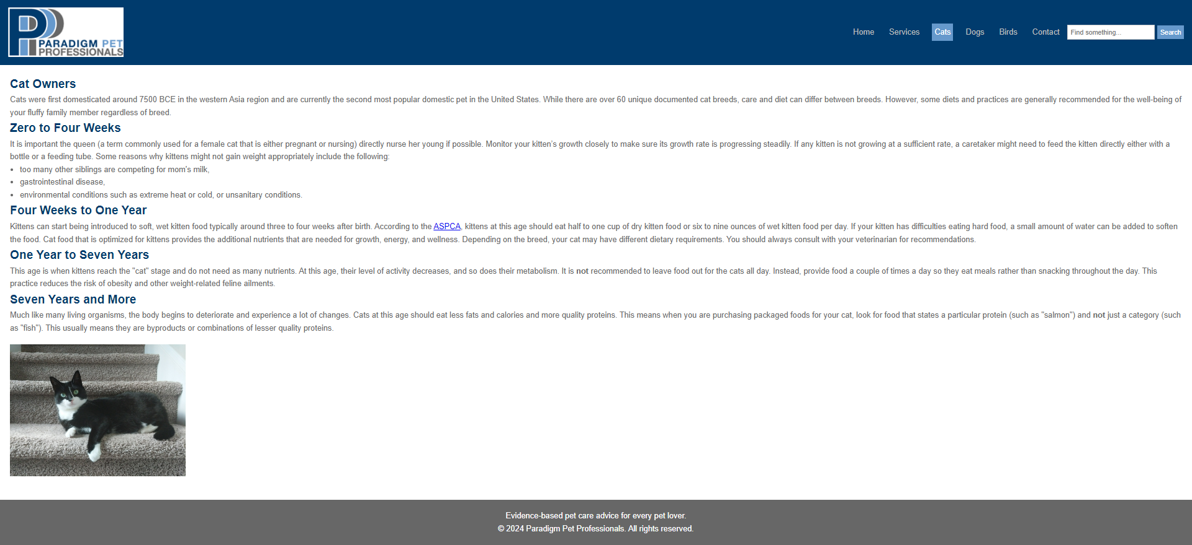

Slide 5
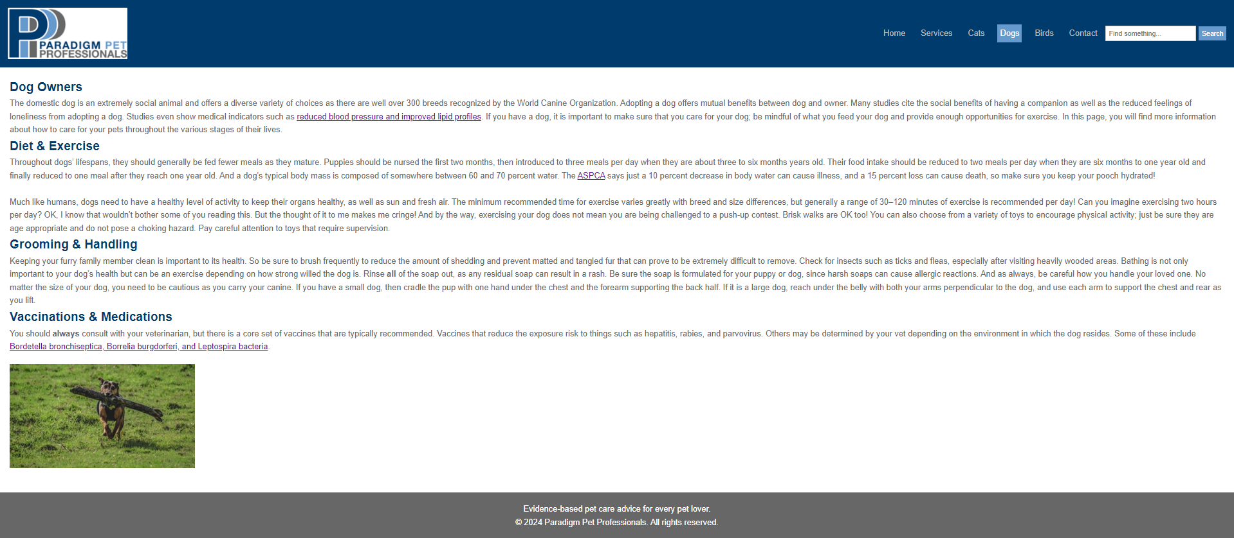

Slide 6
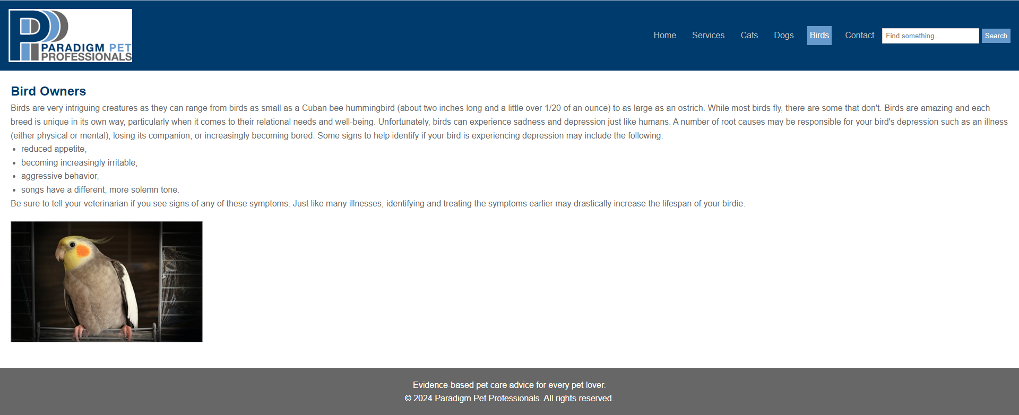

Slide 7
